Slide 1

SEARCH ENGINE
BY-
TEAM ID– T211065
AMMULA SRIVASTAV(IN1240296)

Slide 2
Objective
Create a sophisticated search engine algorithm aimed at retrieving subtitles promptly in response to user queries, focusing particularly on the content of the subtitles. The main objective is to harness the power of natural language processing and machine learning methodologies to elevate the relevance and precision of search outcomes.

Slide 3
Introduction
Develop a groundbreaking search engine algorithm designed to quickly and precisely fetch subtitles in response to user queries, with a focus on prioritizing subtitle content. Utilize state-of-the-art natural language processing and machine learning methodologies to enhance the relevance and accuracy of search results. This state-of-the-art strategy guarantees an improved user experience and effortless access to pertinent subtitle material.

Slide 4
What is Key words Searching
A keyword-based search engine enables users to input specific words or phrases into a search bar to locate relevant information from a database or the internet. By utilizing sophisticated algorithms, it matches these keywords with indexed content, ranks results based on relevance, and presents them in a list format. Prominent examples include Google, Bing, and Yahoo, which expedite information retrieval for users by allowing them to input relevant keywords.

Slide 5
What is Semantic based Search Engine
A semantic-based search engine is a system that retrieves information from a database or the web based on the meaning or context of the user's query rather than just matching keywords. It utilizes natural language processing (NLP) and semantic analysis techniques to understand the intent behind the query and deliver more relevant results. By analyzing the semantics of words and phrases, as well as their relationships, semantic search engines can provide more accurate and contextually appropriate search results compared to traditional keyword-based approaches.

Slide 6
Data Preprocessing
The dataset contains nearly 82000 rows, We extracted 30% of the data and done preprocessing. It involves removing the special characters, punctuations , tokenizing sentences into words, removing links(urls), numbers, timestamps , stops words, converting to lower case and converting into root words using Lemmatization. Additionally, handling missing values and standardizing text formats .

Slide 7
Vectorizer TFIDF
TF-IDF vectorizer, short for Term Frequency-Inverse Document Frequency vectorizer, is a feature extraction technique widely used in natural language processing and information retrieval tasks. It transforms a collection of text documents into a numerical matrix representation based on the frequency of terms in the documents and their importance in distinguishing documents from each other. Using fit_transform() method , it learns from the subtitle content. This vectorizer converts text data into vectors.

Slide 8
Cosine similarity Matrix
The cosine similarity matrix calculates the pairwise cosine similarity between vectors within a dataset. It quantifies the cosine of the angle formed between two vectors, offering a measure of similarity irrespective of their magnitude.
In the realm of natural language processing, cosine similarity serves as a valuable tool for comparing the similarity between text documents represented as numerical vectors, such as TF-IDF vectors. By utilizing a cosine similarity matrix, we can effectively compare each document against every other document in the dataset, facilitating the identification of documents with similar content. Higher cosine similarity scores indicate a greater degree of similarity between vectors, while lower scores indicate dissimilarity.

Slide 9
Building Streamlit web app
To make the search engine more interactive, we have developed a streamlit webapp .It allows the user to enter the query , which is compared against the subtitle corpus to find similar subtitles. The top 5 matching subtitles are displayed to the user on the page.

Slide 10
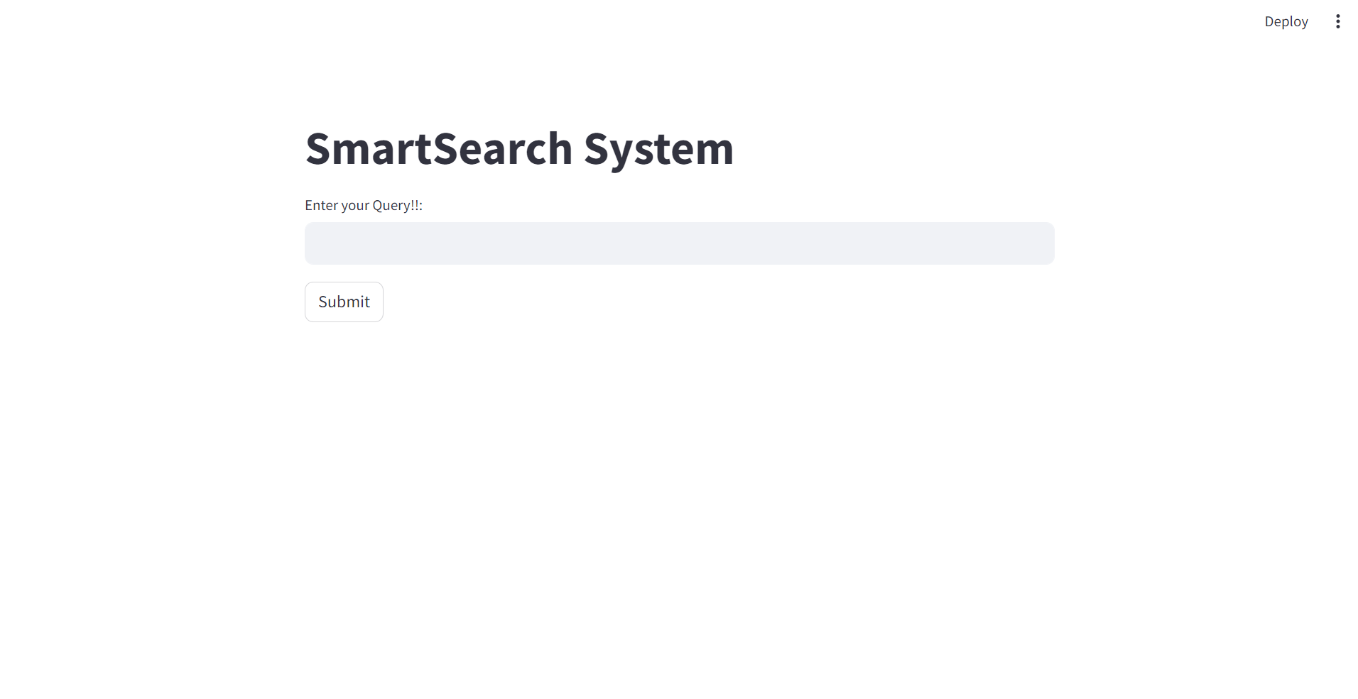

Slide 11
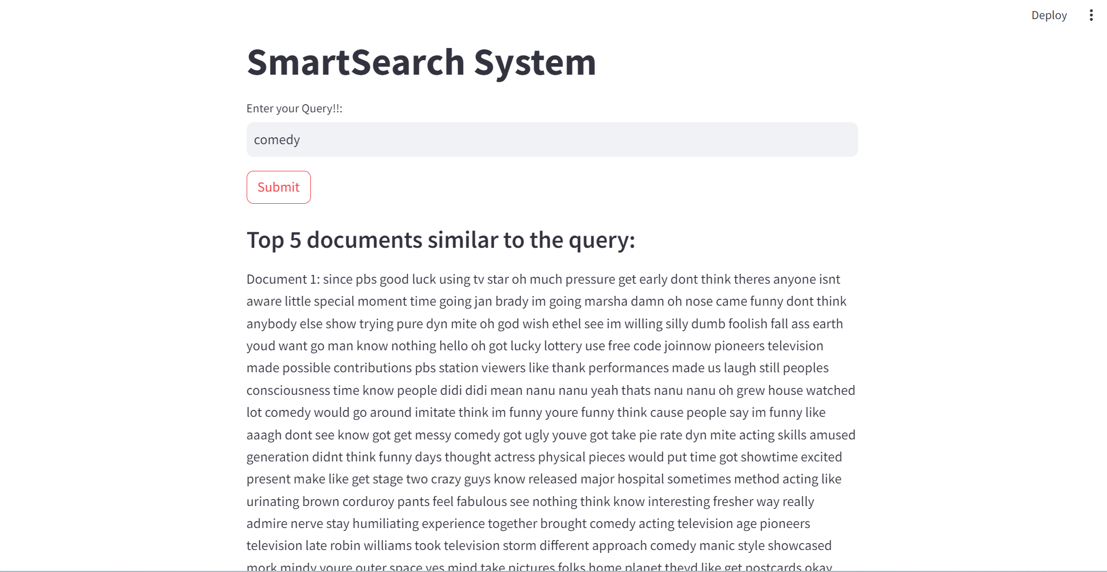

Slide 12

THANK YOU

